Slide 1
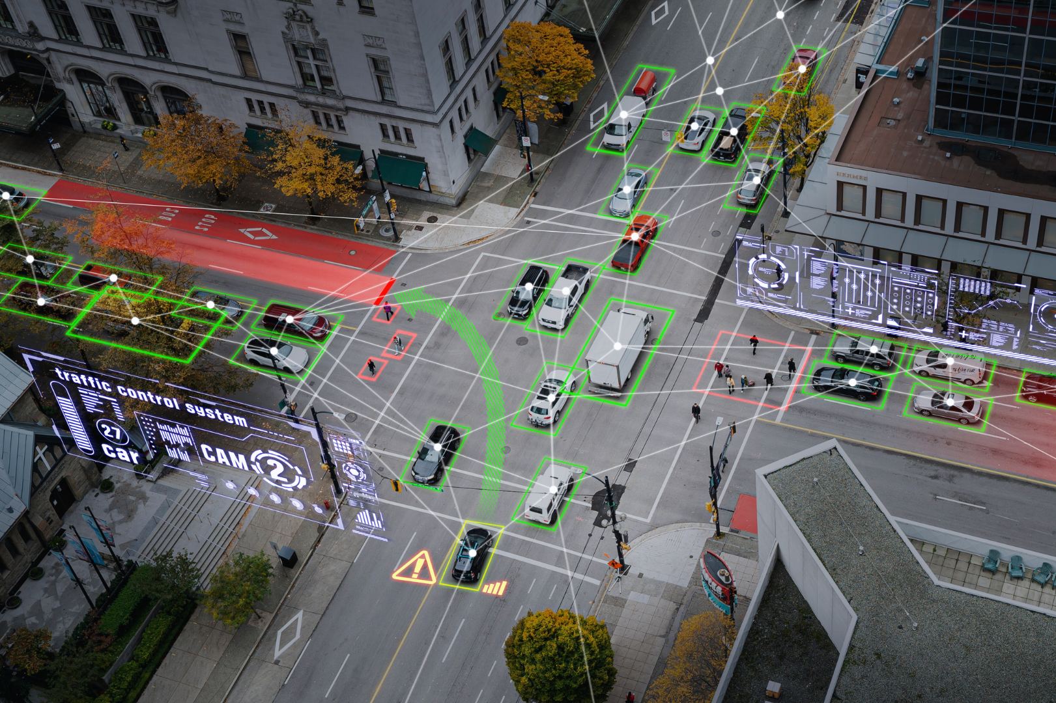
Dynamic Graphs in Traffic and ADAS Using Social Network Analysis to model road connectivity and mobility
Daria-Maria Mesesan
BMDC, Social Networks Analysis
20.10.2025
Notes:
Good afternoon. Today I’ll present Dynamic Graphs in Traffic and ADAS, using Social Network Analysis to model road connectivity and mobility.
I will talk about how we can treat road systems and vehicles as dynamic social networks
by applying concepts learned during our classes to analyze traffic, congestion, and intelligent transport systems on many examples from different articles and real time scenarios.

Slide 2
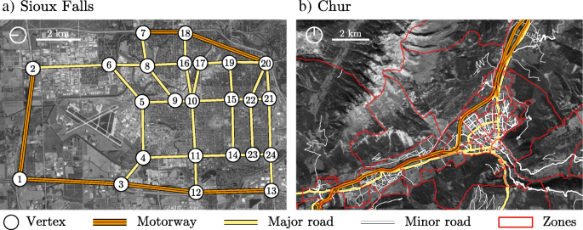
Traffic behaves like a social network (1)
nodes → vehicles and intersections
edges → roads - communication or distance between intersections or vehicles
weight → Each edge has attributes like speed, travel time, distance or reliability
Vehicle flow = information exchange
📊 Traffic = a moving social network.
The figure comparing two traffic networks:
Sioux Falls — grid-like, regular road structure
(b) Chur — organic, irregular layout
Source: Applied Network Science (2019)- “Topological analysis of road networks and its implications for urban traffic modeling.”
Notes:
Just like people form connections, vehicles and intersections form relationships through roads. In this analogy, intersections are nodes, roads are edges, and attributes like speed or delay become edge weights. Vehicle flow equals information exchange — which means traffic is, quite literally, a moving social network.
A comparison between a regular grid network (Sioux Falls) and an organic street layout (Chur). Each node is an intersection, and each edge is a road. It visually shows that, regardless of structure, both cities can be treated as social graphs where roads connect “actors.”

Slide 3
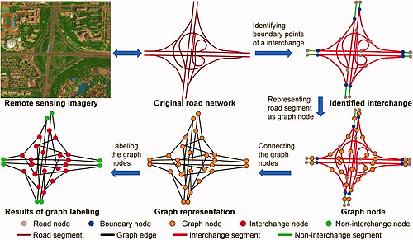
Traffic behaves like a social network (2)
Source: Detecting interchanges in road networks using a graph convolutional network approach
Notes:
This figure shows another example of how a real road interchange can be translated into a network graph. On the left, we start from satellite imagery — real roads captured from above. The middle diagram turns each road segment into a node, and each connection into an edge. The graph labeling process identifies interchange nodes — in red — which are the critical connectors of the whole system. This method, using graph convolutional networks, allows AI to recognize interchanges automatically, just like we detect central figures in social networks.

Slide 4
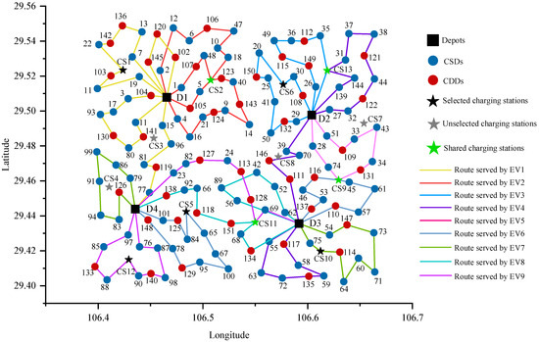
Traffic behaves like a social network (3)
EV-based distribution graph → design reasonable collaborative mechanisms to coordinate various facilities. Implement customer service and CS sharing strategies to reduce transportation costs is particularly important for logistics operators.
Source: Article link
Notes:
Here we see an EV-based distribution graph — a logistics network for electric vehicles.
Each node represents a depot, a delivery center, or a charging station.
The colored lines show routes served by different electric vehicles, and the green stars mark shared charging hubs.
By analyzing the graph structure, we can plan coordinated routes, reduce empty mileage, and balance energy use.

Slide 5
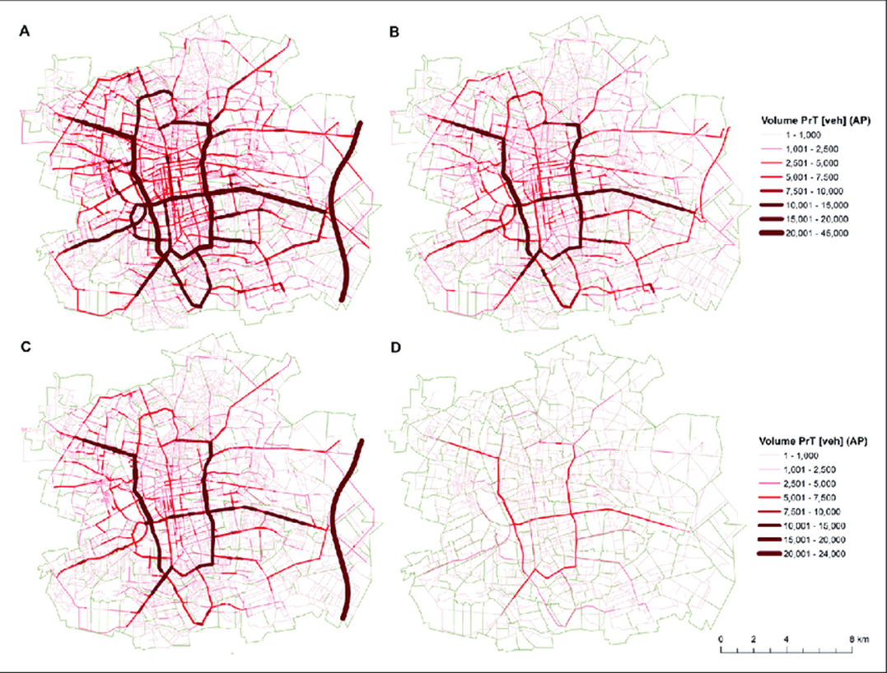
Traffic as a dynamic graph
Static networks show structure
Dynamic networks show evolution
Edge weights change over time (speed, delay, risk)
🕓 Traffic is a time-varying graph, not a fixed map.
Flows of private car traffic on the urban road network on weekdays (AB) and Sundays (CD), all internal, origin-external trips, origin destination and transit trips (AC) and home-work and work-home trips (BD) in Łódź in 2021
Source: Changeability of transport behaviour in a large city from the perspective of working days and Sundays: The case of Łódź, Poland
Notes:
This map from Poland visualizes how traffic flow changes between weekdays and weekends. The darker lines indicate higher volumes — over 20,000 vehicles per day. The structure itself doesn’t change, but the weights on the edges do.
That’s the essence of dynamic graphs: traffic is not static. Edge weights evolve with time, weather, and human routines — a living network, not a fixed map

Slide 6
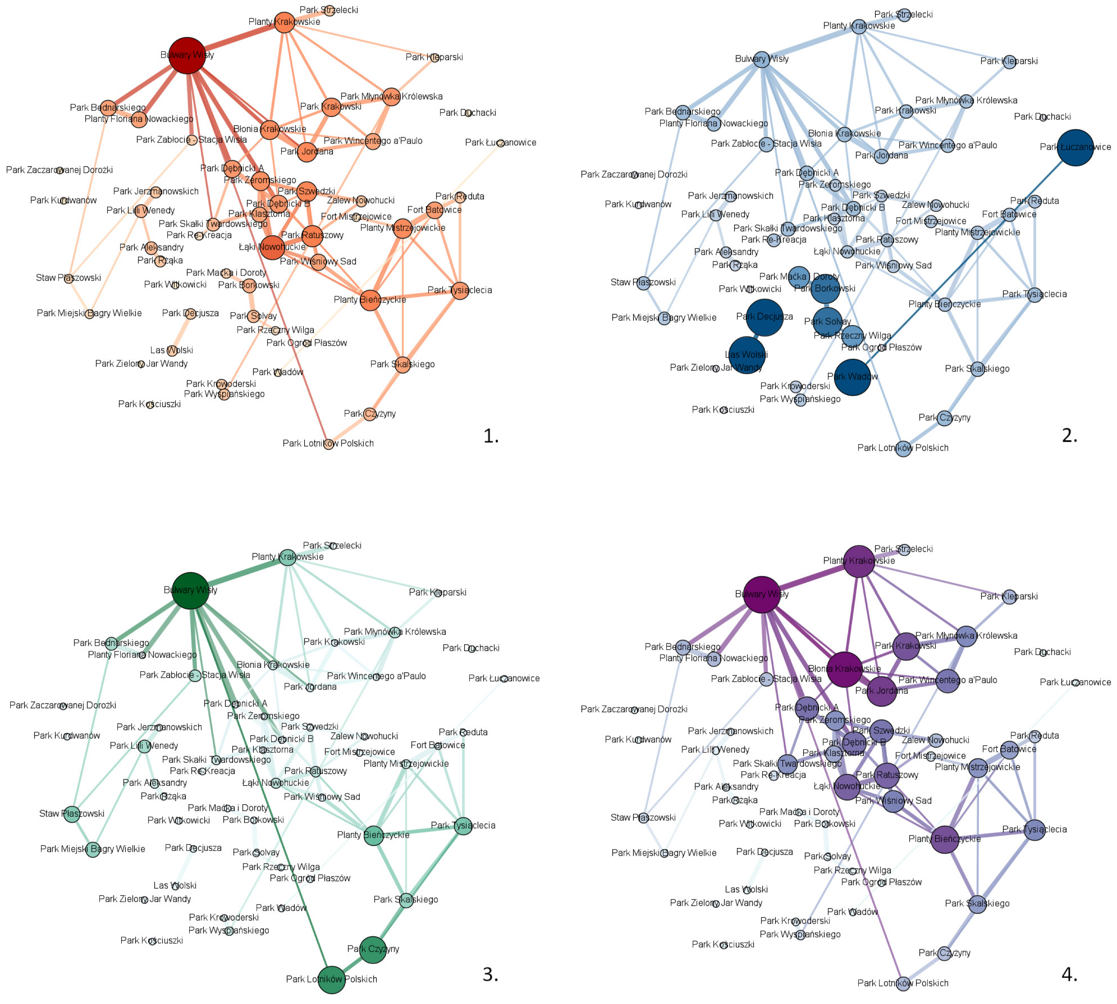
Degree Centrality: identifying traffic hubs
Degree centrality = how many roads directly connect to each intersection.
High-degree nodes = traffic hubs
Key for signal optimization and congestion management
📊 High-degree intersections spread influence in the traffic network.
The figure shows Kraków’s network of public parks, showing how closely green spaces are clustered.
Source: Królikowska, K. (2023). “Exploring Green Space Connectivity Using Social Network Analysis: A Case Study of Kraków Parks.” Sustainability, 15(18), 13458.
Notes:
Degree centrality measures how many connections an intersection has.
The graphs here show Kraków’s network of public parks, used as an analogy for traffic.
Large circles represent high-degree nodes — those that connect to many others, forming ‘hubs.’
Just like a busy roundabout or major intersection, these nodes influence how movement spreads through the city.
Optimizing such hubs is key for congestion control and signal coordination.

Slide 7
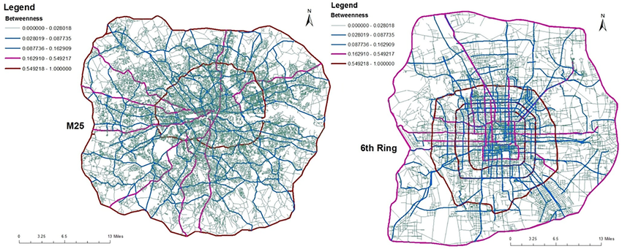
Betweenness Centrality: bottlenecks
Betweenness = how often a node lies on shortest paths
High-betweenness = critical connectors or bottlenecks
📍 Betweenness identifies where congestion originates.
Left panel: London; Right panel: Beijing.
Source: Resilience of Self-Organised and Top-Down Planned Cities-A Case Study on London and Beijing Street Networks
Notes:
This comparison between London and Beijing highlights where traffic bottlenecks emerge.
Red roads have high betweenness — meaning they lie on most of the shortest paths between other points.
In both cities, the outer ring roads — the M25 in London and the 6th and 4th Ring in Beijing - they act as vital circulatory systems.
If these routes slow down, the entire network suffers

Slide 8
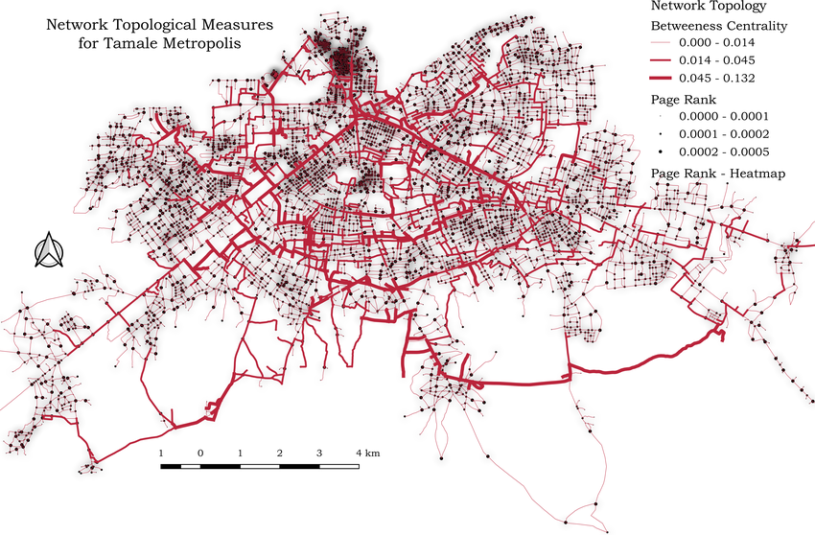
Betweenness Centrality: bottlenecks
Map of network topological measures of betweenness centrality of road segments and page rank of nodes for Tamale metropolis. Dark shaded areas represent high values of page rank and light shaded areas represent low values of page rank.
Source: Characterising the structural pattern of urban road networks in Ghana using geometric and topological measures
Notes:
This map from Ghana overlays betweenness centrality and PageRank values.
Darker lines show higher PageRank - intersections that strongly influence the rest of the network.
You can see that the densest center of Tamale carries the greatest connectivity, while peripheral zones depend on a few major corridors.
This approach helps developing cities pinpoint where new roads or alternate routes will have the biggest impact

Slide 9
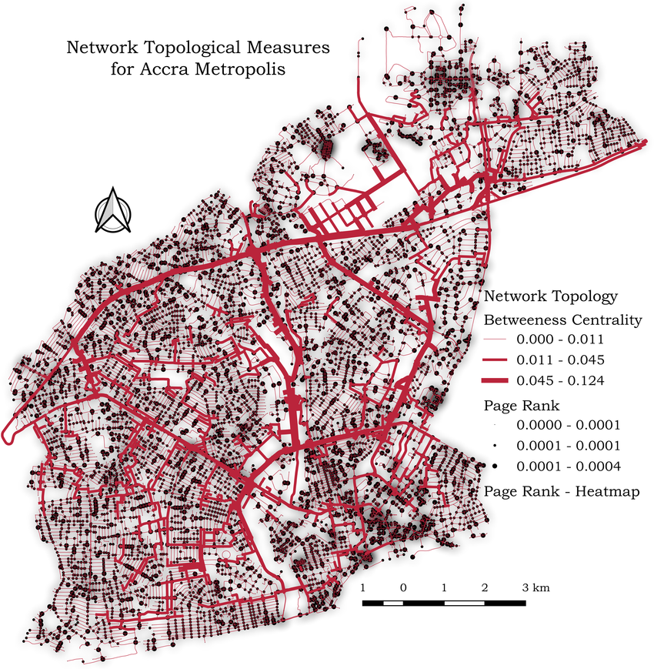
Betweenness centrality & page ranks
PageRank measures influence within a network.
In traffic, it identifies intersections that matter most for overall flow.
A node with high PageRank connects to many important routes
These areas act like “main pages” on the web → if one fails, the whole system feels it.
Source: Characterising the structural pattern of urban road networks in Ghana using geometric and topological measures
Notes:
Here’s another related example from Accra, Ghana’s capital.
Just like Google ranks web pages by importance, PageRank can rank intersections by their impact on traffic flow.
A small street linked to highly connected roads can have a high PageRank — even if it’s not large.
They’re not always the busiest roads, but they’re the most structurally important.
When one of these nodes is blocked, its effect ripples through the entire urban system.

Slide 10
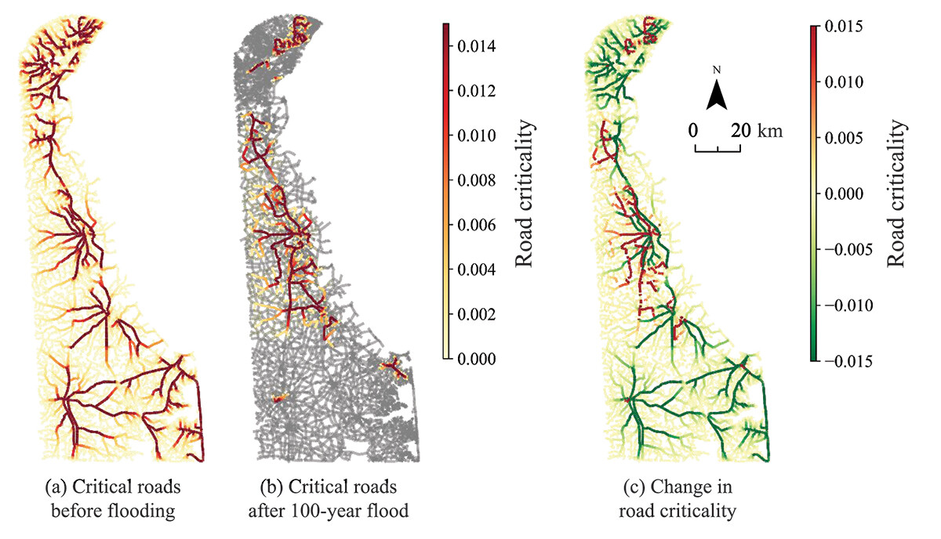
Closeness Centrality: accessibility & node criticality
High closeness = easily reachable nodes
Critical roads for access to hospitals through the Delaware road network . The road criticality is spatially mapped and represented for three cases: (i) before flood; (ii) after 100-year flood; and (iii) change in critical roads. The grey roads in (b) represent the flooded and disconnected links in the system.
Source: Critical facility accessibility and road criticality assessment considering flood-induced partial failure
Notes:
This study from Delaware visualizes closeness and road criticality before and after a major flood.
In panel (a), critical roads (in red) provide fast access to hospitals. In panel (b), flooding disconnects large portions of the network, sharply reducing closeness.
The right-hand map shows the change in accessibility, revealing which routes are most essential during emergencies. In disaster management, such nodes become priority repair targets.

Slide 11
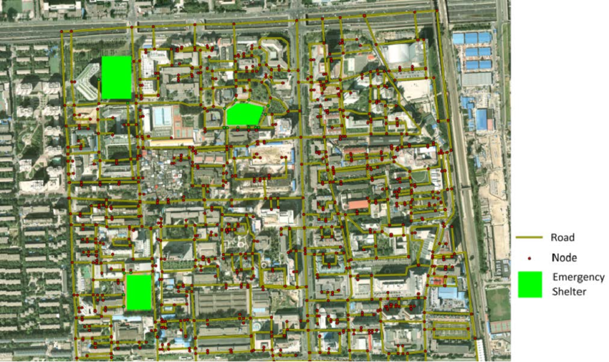
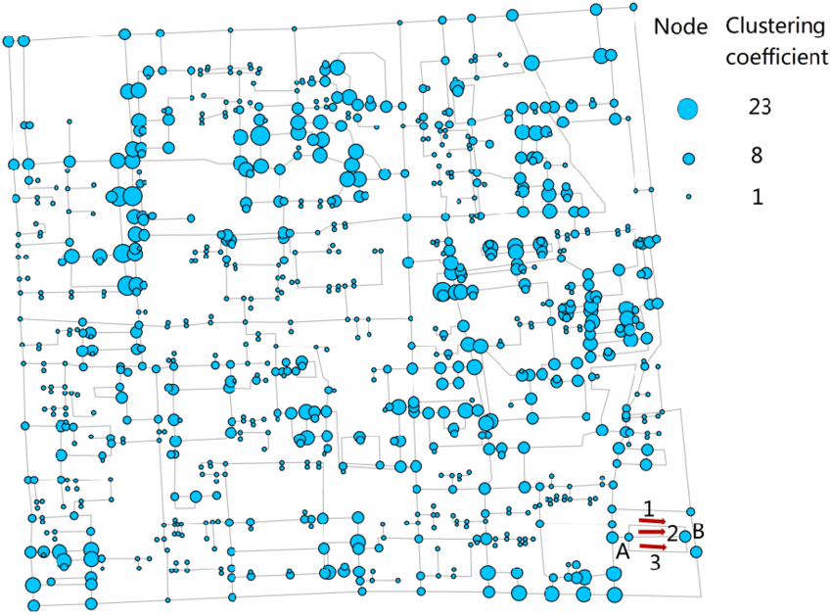
Clustering Coefficient
High clustering = alternative paths exist
The study focuses on road vulnerability for population evacuation in case of emergency.
Fig 1 (above) → Roads and emergency shelters distribution of study area
Fig 2 ( below) → Special clustering coefficient of different road nodes
Source: Analysis of Road Vulnerability for Population Evacuation Using Complex Network
Notes:
Clustering coefficient shows how interconnected neighborhoods are.
The top figure maps emergency shelters and road nodes; the bottom shows each node’s clustering value.
A high clustering coefficient means local redundancy — if one road fails, others can take over.
This redundancy improves evacuation safety, allowing cities to remain functional under stress.
In short, clustering measures the resilience of urban mobility.

Slide 12
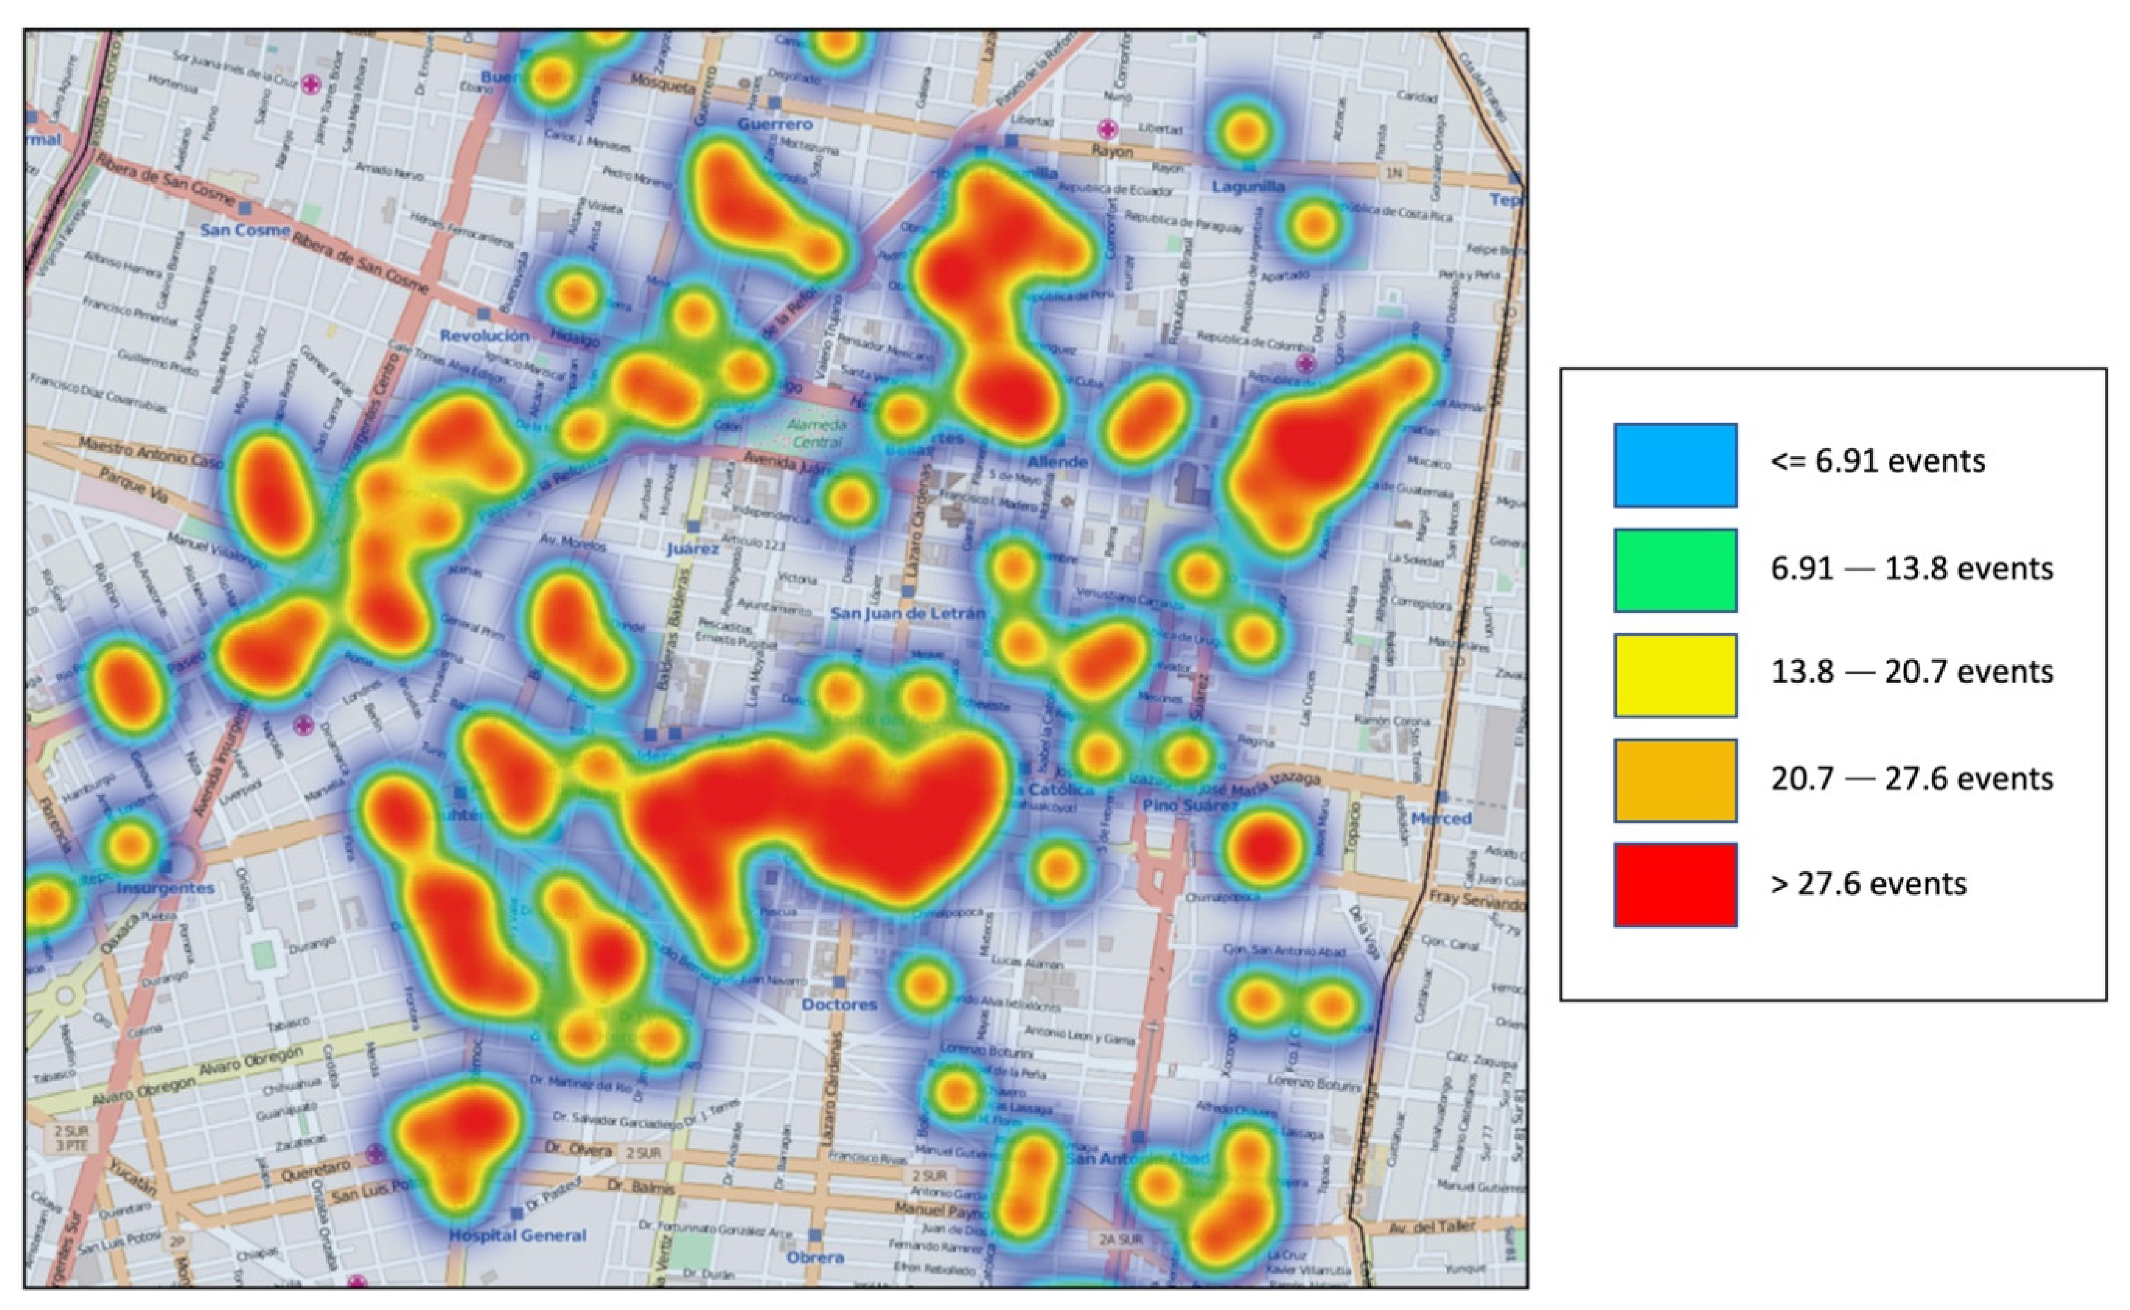
Traffic spreads like rumors
Congestion spreads through connected nodes.
A jam in one intersection can cascade city-wide.
Traffic Congestion Analysis Based on a Web-GIS and Data Mining of Traffic Events from Twitter
Source: https://www.mdpi.com/1424-8220/21/9/2964
Notes:
Traffic behaves like information in a social network one blocked node can cause a chain reaction through all its connected neighbors.
this heatmap visualizes how traffic congestion propagates through a city — almost like rumors spreading through social media. Each red zone marks areas with the highest frequency of traffic events extracted from Twitter. Congestion starts locally but diffuses across connected intersections. One delay in the network can trigger a chain reaction city-wide, showing that traffic behavior truly follows the logic of information diffusion.

Slide 13
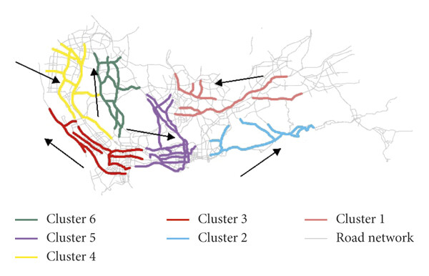
Clustering & communities in traffic (Shenzhen example)
Traffic naturally forms clusters → local regions of dense interaction.
Community detection groups intersections that influence each other most.
Helps identify functional zones — neighborhoods, business areas, school traffic loops.
Clustering example travel patterns of taxi trajectory data collected on workday in Shenzhen city, China.
Source: An Improved Fuzzy Trajectory Clustering Method for Exploring Urban Travel Patterns
Notes:
This map shows how taxi trajectories in Shenzhen, China, naturally form clusters — each color represents a distinct community of movement.
The red, green, and purple clusters show areas with dense internal flow — where vehicles circulate frequently within that region.
Community detection like these helps planners identify functional zones: residential neighborhoods, business areas, or school loops that share common mobility behavior.

Slide 14
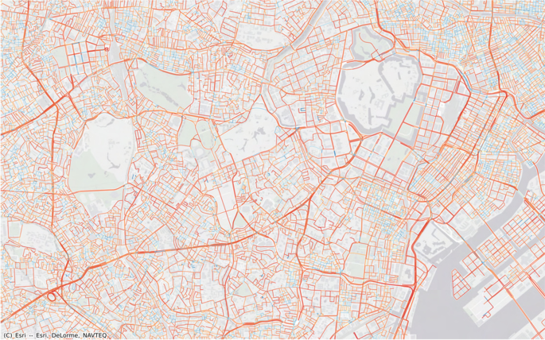
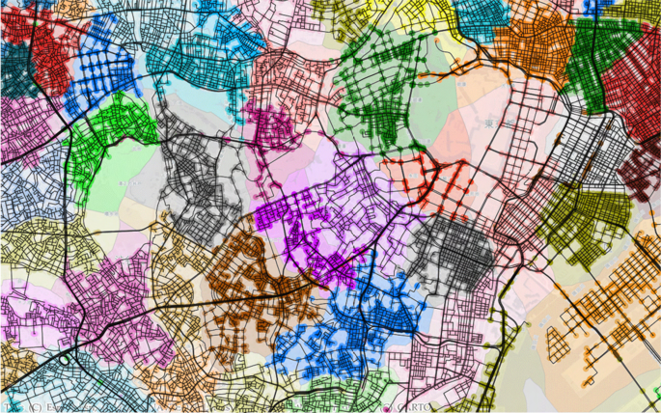
Clustering & communities in traffic (2)
Tokyo road data → from data about roads and intersections to detecting communities (neighborhoods)
The nodes belonging to each detected community and the neighborhood polygon generated from those nodes using , 300 m subgraphs, and all variables.
Source: Neighborhood discovery via augmented network community structure
Notes:
In this example from Tokyo, we move from raw road data (on the left) to community detection on the right. The algorithm divides the city into colored polygons, each representing a neighborhood automatically discovered through movement patterns. What’s powerful here is that community boundaries match real-world divisions like shopping districts or housing zones, showing that traffic alone can reconstruct the ‘social geography’ of a city.

Slide 15
Cars as talking nodes → Smart Mobility
Vehicles form temporary communication networks.
Traffic jams are avoided. No more need for traffic lights,
Data flows faster than traffic itself.
The goal → No more human drivers?
➔ V2X communication systems ⬅
Source: https://youtu.be/iHzzSao6ypE?si=MTd0sIdgTTfpdaXd
Notes:
So far, we’ve analyzed traffic as if vehicles were passive elements, but in smart mobility, they become active nodes.
Modern cars exchange data in real time through what’s called V2X communication — vehicle-to-vehicle and vehicle-to-infrastructure.
This allows them to adjust speed, coordinate merging, and even eliminate the need for fixed traffic lights, as depicted in the video example.
Data flows faster than the cars themselves, turning traffic into a self-organizing, intelligent system.
The big question remains - if cars could talk to each other, would we still need human drivers at all?
That question is still to be answered. As a conclusion, from static roads to dynamic communication networks, traffic behaves just like a social system. Each vehicle, road, and intersection plays the role of a node — cooperating, competing, and adapting in real time. Social Network Analysis gives us the tools to understand and shape that interaction — building the foundation for smarter, safer, and more efficient cities.

Slide 16
Thank you for your attention! Q&A Session
Daria-Maria Mesesan
BMDC, Social Networks Analysis
20.10.2025

